Slide 1
Delivering and Managing The Connected Enterprise

Slide 2
1
2
3
4
What is it?
Why use it?
Demonstration
Release Summary
5
6
Hardware Benefits and Portfolio
V-FLEX Licensing

Slide 3
ThinManager®
Content Delivery and Device Management
Content Types
Configuration
Delivery
PanelView™ Plus
PanelView™ 5000
Devices
HMI
ERP
MES
CMMS™
User X
Users
Group X
Web Content
Role X
ThinManager® provides secure configuration and delivery of content
Locations
IP Camera
USB Camera
…AND MORE!
Notes:
Script:
Some of the more common Content Types are represented in the column on the left.
ThinManager can connect to VNC Servers as sources of content. This will enable shadowing of the PanelView Plus, and plug it into all of the unique ways that ThinManager can assign and deliver content.
ThinManager also connects to and delivers Windows based content.
It is important to note that ThinManager is an agnostic platform, so any Windows based content can be delivered.
The most common way that Windows based content is delivered with ThinManager is using Microsoft’s Remote Desktop Services (formerly called Terminal Services). It is not the only way, but the most common way.
Often times, it is assumed that ThinManager requires, or is dependent on Remote Desktop Services, but that is not the case.
With that said, while it is not required, since ThinManager is often deployed with Remote Desktop Services, you will typically find ThinManager installed on a Remote Desktop Server.
What is a Remote Desktop Server? This is a Windows Server based operating system (like Server 2008/2012/2016) that has the Remote Desktop Services role installed and configured. With this role installed, the server can then host multiple, independent Remote Desktop sessions from devices like thin clients, tablets, etc.
So, instead of installing FactoryTalk View SE on a number of PCs throughout the facility, you could instead install the FactoryTalk View SE Client on a Remote Desktop Server and use ThinManager to launch and distribute multiple instances of it.
In addition to Windows-based content, ThinManager supports IP or USB Cameras. ThinManager can tap into the camera’s video stream and deliver it to a device managed by ThinManager.
ThinManager also supports Terminal Shadowing. Shadowing is the ability to see a terminal remotely. Shadowing is supported through the ThinManager Admin Console, so you can see and remotely control any terminal managed by ThinManager centrally. We also extend this concept so terminals can shadow other terminals – this is called Terminal to Terminal shadowing. A single terminal can be shadowed by several other terminals. The shadowed sessions can be remotely controllable or view only.
So, what are the ways in which ThinManager can deliver the content of the Connected Enterprise?
ThinManager can assign and deliver content in 3 ways – By Device, By User and By Location.
By Device:
Every device managed in ThinManager will have a unique Terminal Profile.
The Terminal Profile is linked to the device based on the device’s MAC address.
The Terminal Profile defines the device’s default content and its other characteristics (i.e.: if it needs a touchscreen driver, is it permitted to be shadowed, etc.)
It is very common to assign FactoryTalk View SE as the default content for a device so it is automatically delivered when the device boots up.
By User:
In addition, content can be assigned to a user or a user group.
In this way, when a user logs in at any terminal managed by ThinManager, that user’s assigned content will be delivered (i.e.: a Maintenance user may receive an instance of Logix Designer, or maybe the Work Order System Client, etc.)
By Location:
Location is the foundation of ThinManager’s mobility initiative, called Relevance.
It allows content to be assigned and delivered to a mobile device based on its physical location.
As an example, a QR Code could be placed on a PLC panel. When a Maintenance user scans the QR Code, Logix Designer could be delivered to their mobile device with the correct ACD file opened up automatically.
As another example, maybe you permit a user to access the FactoryTalk View SE Client from their mobile device, but you want to physically limit where they can access it from. With Relevance, you can geo-fence content in based on the mobile device’s location (using Bluetooth Beacons, GPS, Access Points, etc.)
==========
SHORT SCRIPT:
ThinManager can easily deliver all kinds of content that your workforce needs to do their jobs. ThinManager securely delivers that content to any combination of device, user or location. This graphic shows examples of content, device, user and location.
Thin client networks are inherently more secure than traditional PC networks but ThinManager increases security even further by employing powerful user authentication techniques and the ability to designate specific locations for content delivery within your facility.
ThinManager is a Content Delivery and Device Management Platform.
Content Sources can be created and managed centrally.
Each device managed by ThinManager is assigned a unique terminal profile within ThinManager.
A device can be a thin/zero client, mobile device, or PC and each are managed in exactly the same way within ThinManager.
Content can be assigned and delivered by any combination of Device, User, and Location.

Slide 4
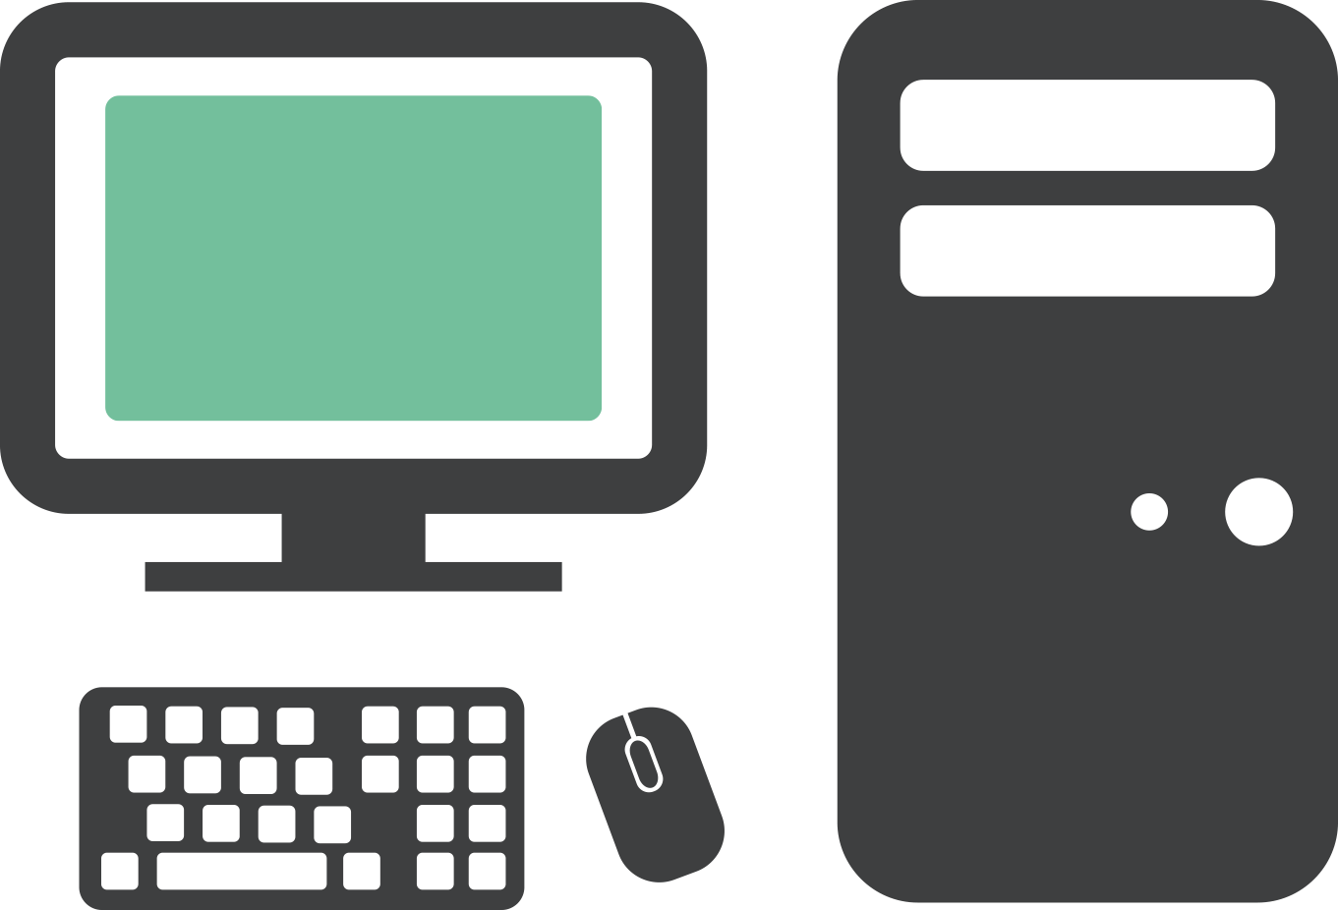
Traditional Automation Network
Dedicated PCs for Dedicated Applications
Control Room
OS
OS
APPS
USB
ACCESS
APPS
USB
ACCESS
OS
OS
OS
APPS
USB
ACCESS
APPS
USB
ACCESS
APPS
USB
ACCESS
ANTI-
VIRUS
MOVING
PARTS
ANTI-
VIRUS
MOVING
PARTS
ANTI-
VIRUS
MOVING
PARTS
ANTI-
VIRUS
MOVING
PARTS
ANTI-
VIRUS
MOVING
PARTS
OS
OS
OS
APPS
USB
ACCESS
APPS
USB
ACCESS
APPS
USB
ACCESS
OS
OS
APPS
USB
ACCESS
APPS
USB
ACCESS
ANTI-
VIRUS
MOVING
PARTS
ANTI-
VIRUS
MOVING
PARTS
ANTI-
VIRUS
MOVING
PARTS
ANTI-
VIRUS
MOVING
PARTS
ANTI-
VIRUS
MOVING
PARTS
Plant Floor
Plant Floor Offices
Notes:
Script:
Traditionally, Windows based applications were hosted on PCs in manufacturing areas.
Quite often, these PCs ran dedicated applications like FactoryTalk View SE, restricting access to the Windows desktop.
In general, a Windows desktop experience is not required, and sometimes not desired – especially on the Plant Floor or in the Control Room.
This environment requires management of support of many operating systems, many times each at different version and service pack levels.
In addition to the locally installed OS, the applications required must be managed at each PC, and anti-virus must be deployed and managed as well.
These PCs are generally not industrial, so they tend to have moving parts like hard drives, fans, and commercial grade power supplies that are all prone to failure.
Replacement of a PC, even with well managed external images, will typically take hours, resulting in costly downtime.
Lastly, the PCs are more susceptible to virus infection because their USB ports are used with flash drives.

Slide 5
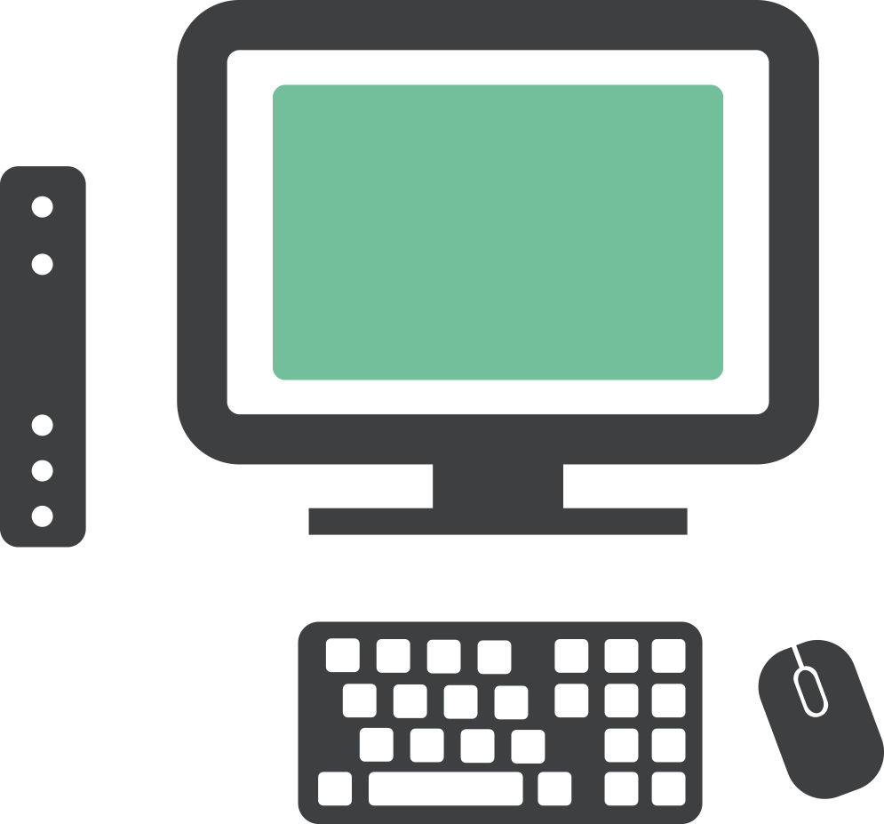
ThinManager Solution
Replace PCs with Thin Clients and Manage Centrally
Control Room
OS
APPS
ANTI-
VIRUS
OS
OS
APPS
USB
ACCESS
APPS
USB
ACCESS
OS
OS
OS
APPS
USB
ACCESS
APPS
USB
ACCESS
USB
ACCESS
APPS
ANTI-
VIRUS
MOVING
PARTS
ANTI-
VIRUS
MOVING
PARTS
Server Room
ANTI-
VIRUS
MOVING
PARTS
ANTI-
VIRUS
MOVING
PARTS
ANTI-
VIRUS
MOVING
PARTS
OS
OS
OS
APPS
USB
ACCESS
APPS
USB
ACCESS
APPS
USB
ACCESS
OS
OS
APPS
USB
ACCESS
APPS
USB
ACCESS
ANTI-
VIRUS
MOVING
PARTS
ANTI-
VIRUS
MOVING
PARTS
ANTI-
VIRUS
MOVING
PARTS
ANTI-
VIRUS
MOVING
PARTS
ANTI-
VIRUS
MOVING
PARTS
Plant Floor
Plant Floor Offices
Notes:
Script:
A ThinManager solution looks more like this – where PCs are generally replaced by thin clients. Any of the Windows based applications are then hosted centrally – typically on a Remote Desktop Server.
This architecture dramatically reduces the number of operating systems that need to be maintained – whether they are physical or virtual.
It also increases security at the endpoint, because nothing is stored on the actual ThinManager managed thin client. And USB ports on these devices are disabled by default for everything except keyboards and mice.
Adding ThinManager to this deployment provides an added layer of management that brings some very unique, plant-floor centric capabilities to the table.
As a side note – PCs can be retained and managed in a ThinManager deployment as well.
ThinManager offers a Windows based application called WinTMC that will essentially emulate a ThinManager thin client from a Windows OS. This is sometimes utilized if there are some applications that must continue to run locally, while additional remote content is managed from ThinManager.
Alternatively, some PCs can be PXE booted (PXE is an Intel standard = Preboot Execution Environment = a way to deliver firmware/operating systems over the network at boot time), where the PC would be booted from the ThinManager firmware, as opposed to its locally installed OS.

Slide 6
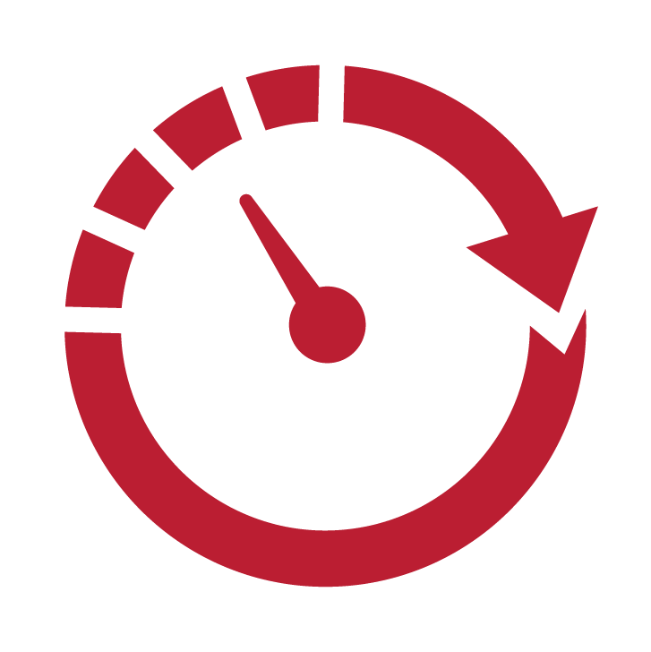
Why Customers Use ThinManager®
1
Configuration Wizards
Easily select the functionality you need without any coding
Ease of use
No local configuration of thin client required
Admin console and terminal to terminal shadowing
Industrial thin clients & broad touch screen support
Control thin client session inside application (ActiveX control)
2
Reduce Downtime
Automatic Remote Desktop Server failover
Redundant networking options at thin client
Aggregate multiple content sources at 1 terminal
Quick Replacement
Most ThinManager® thin clients can be replaced by anyone in under 2 minutes without any loss of data
Improve Operational Efficiencies
OT-Centric solution designed for the plant floor
Visualize content with tiling & virtual screening
IP/USB Camera integration
Location-based mobility (Relevance®)
3
Notes:
ThinManager-managed devices are managed centrally using the Admin Console – no configuration is required at the device.
This makes terminal replacement extremely simple. In fact, anyone can be trained to perform a terminal replacement, significantly reducing downtime.
ThinManager is purpose-built for manufacturing environments, due to its evolution on the plant floor for the last 18 years.
As opposed to managing numerous PCs (either physical or virtual), each with their own Windows OS and applications to maintain, ThinManager presents a much simpler centralized management paradigm.
The ThinManager OS is delivered to a thin client right at boot time, and its configuration is easily created and managed within the ThinManager Admin Console.
Windows-based content can be made highly available by simply configuring a failover Remote Desktop Server. If the primary Remote Desktop Server becomes unavailable, the thin client will automatically fail to the secondary Remote Desktop Server.
ThinManager supports over a dozen touchscreen drivers – and you won’t have to figure out where to install the driver (on the server, thin client, etc.) – you simply add the correct driver to the terminal’s profile.
ThinManager also support redundant networking on thin clients with more than one network interface card (NIC).
Any terminal managed by ThinManager can be remotely monitored and/or controlled from the ThinManager Admin Console.
This shadowing concept can be taken a step further where ThinManager enables terminals to shadow each other.
The real power of ThinManager is its ability to aggregate multiple content sources at a single device (i.e.: Windows based applications, cameras, VNC sessions to PanelViews, etc.), creating composite applications. These multiple content sources can be visualized simultaneously using Tiling or Virtual Screening.
ThinManager also provides location based content delivery to mobile devices, so content can be made available only in the physical locations that permit it.
Lastly, ThinManager ships with an ActiveX control called TermMon which extends ThinManager functionality natively to ActiveX containers, like FactoryTalk View SE.
Two of the best reasons to use ThinManager are listed in the gray boxes. Every asset managed by ThinManager can be configured using the configuration wizard tool. Simply select the settings you want and deploy with no coding required.
When a ThinManager-managed terminal does fail, it can be replaced in minutes instead of hours with no loss of data. Replacement is so simple that anyone who can plug in power, network and monitor cables can replace a ThinManager terminal.

Slide 7
ThinManager Demonstration
Display Server Creation Tiling and MultiSession
Display Client Creation MultiMonitor Support
Device Delivered Content User Delivered Content
Terminal Replacement Location Delivered Content

Slide 8
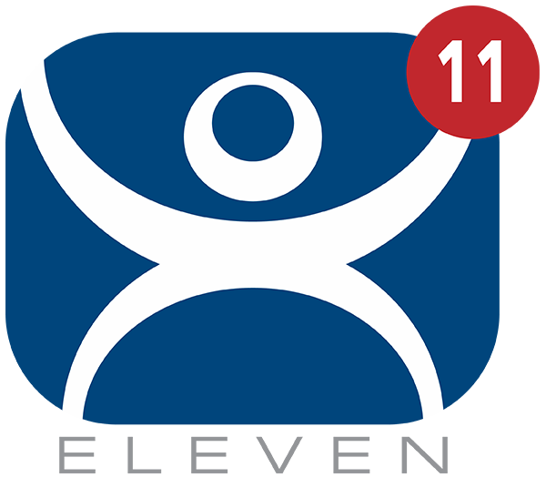
ThinManager 11.x Release Summary
GENERAL
Localization – Phase 1
UEFI support
Display Client Groups
PRODUCTIVITY
FactoryTalk Activation and Common Installer
FTView licensing improvements
VersaView 5200 support and differentiation
Requires FTV11
VISUALIZATION
More flexible touchscreen navigation
Freeform MutliMonitor
DDC Support for Brightness Control
SECURITY
USB badge reader module
Additional Fingerprint Reader Support
nymi band Authentication Support Phase 1
PIN Obscurity/Complexity
MOBILITY
Tiling, Virtual Screens,
IP Camera for aTMC, iTMC
Configurable prefix/suffix for barcode scanning
MISC.
TermMon .NET Component
Configurable Heartbeat for ActiveX Control
Notes:
GENERAL
Localization – Phase 1
Phase 1 of Localization will provide support for non-English keyboards. The On-Screen Keyboard (OSK) will be configurable for other languages as well. Prompts will be addressed in Phase 2 which will be included in version 12. There are no plans to change the ThinManager Admin Console to other languages. It will remain in English.
UEFI Support
Prior to ThinManager version 11, the ThinManager firmware required a traditional BIOS. Hardware manufacturers have started to drop support for Legacy BIOS. By supporting UEFI, ThinManager will continue to be viable on the latest x86 thin/zero clients. UEFI will also enable secure boot options for the VersaView 5200 family in the future.
Display Client Groups
Similar to other ThinManager objects, Display Client grouping will allow for better organization of Display Clients – especially for larger deployments.
PRODUCTIVITY
FactoryTalk Activation and Common Installer
ThinManager 11.0 will provide an option to use traditional Master Licensing or FactoryTalk Activation.
FactoryTalk View SE Licensing Benefits
With FactoryTalk View SE 11 and ThinManager 11, using FactoryTalk Activation, a single FactoryTalk View SE Client license will enable the delivery of an unlimited number of SE Client sessions (MultiSession and/or Failover) to a terminal.
VersaView 5200 Support
Dual 4K unit – Oct 2018, Multi 4K (3 or 7 displays) – Jan 2019
VISUALIZATION
More Flexible Touchscreen Navigation
USB touchscreen module will be configurable for touch and hold time period to present Display Client selection and/or other ThinManager actions (i.e. Tile, Calibrate, etc.)
MultiMonitor Enhancements
ThinManager 11 will support up to 7 displays (in order to support the VersaView 5200 Multi 4K thin client to be released in Jan 2019).
SECURITY
USB Badge Reader Module
This new USB badge reader module will enable ThinManager to support a broader range of badge reader manufacturers. This particular module will work for badge readers that emulate a keyboard.
MOBILITY Tiling, Virtual Screens, IP Camera for aTMC, iTMC
Tiling, Virtual Screens and IP Camera support will be added to ThinManager’s Android and iOS mobile clients. This will allow a Control Room style composite application to be taken mobile, allowing mobile users to monitor multiple sources of content simultaneously.
MISCELLANEOUS
TermMon .NET Component
ThinManager’s existing TermMon ActiveX control will be made available as a .NET component. This will enable end users who leverage .NET development environments to take advantage of ThinManager’s remote programmability capabilities.
Biometric Facial Recognition (Post 11.0 Release)
An advanced look at Facial Recognition will be presented in the Innovations Zone at Automation Fair 2018. In 2019, ThinManager will support Facial Recognition using RealSense USB cameras, enabling a user to register a face at a ThinManager terminal and associate that face with a Relevance User. ThinManager’s implementation of Facial Recognition will learn a user’s face as it changes – allowing multiple faces (i.e.: with/without PPE) to be associated with a single user.

Slide 9
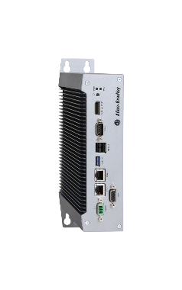
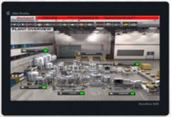
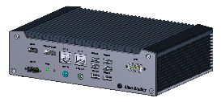
VersaView® 5200
Rockwell Automation® Industrial Thin Client Hardware
 | VersaView® 5200 Single Display | VersaView® 5200 Panel | VersaView® 5200 Dual Display | VersaView® 5200 Dual 4K Display | VersaView® 5200 Multi 4K Display
Previously Known As | VersaView® 5200 “Basic” | VersaView® 5200 “Industrial” Panel | VersaView® 5200 “Industrial” | VersaView® 5200 “Mid” | VersaView® 5200 “Complex”
Commercial Collateral References | VersaView® 5200 Single Display | VersaView® 5200 Panel | VersaView® 5200 Dual Display | VersaView® 5200 Dual 4K Display | VersaView® 5200 Multi 4K Display
Product Nameplate Label | VersaView® 5200 Box Thin Client | VersaView® 5200 Panel Thin Client | VersaView® 5200 Box Thin Client | VersaView® 5200 Box Thin Client | VersaView® 5200 Box Thin Client
Trade Dress on Product | Allen-Bradley® | Allen-Bradley® VersaView® 5200 | Allen-Bradley® | Allen-Bradley® | Allen-Bradley®
Product Family | VersaView® 5200 Industrial Thin Clients | VersaView® 5200 Industrial Thin Clients | VersaView® 5200 Industrial Thin Clients | VersaView® 5200 Industrial Thin Clients | VersaView® 5200 Industrial Thin Clients
Sub Product Family | Non-Display | Panel | Non-Display | Non-Display | Non-Display
Catalog Number | 6200T-BA | 6200T-xxWA | 6200T-NA | 6200T-KB | 6200T-RC 6200T-RE
Notes:
ThinManager also supports the new VersaView thin client series as ThinManager-Ready thin client.
All of these units will automatically boot from ThinManager.
All of these units are industrial grade to support more strenuous work environments.
All of these units should have a life cycle that is two to three times that of their PC counterparts.

Slide 10
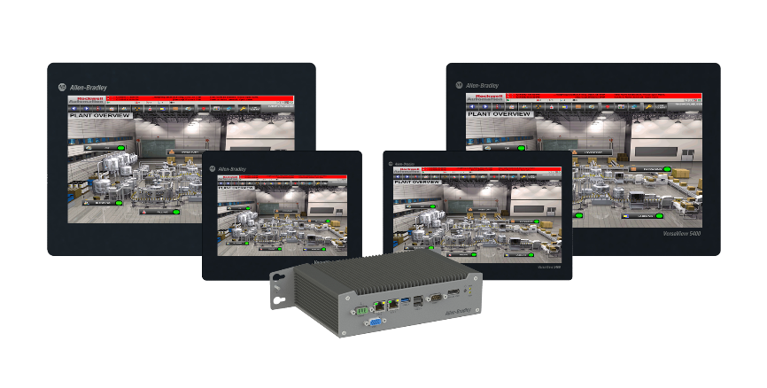
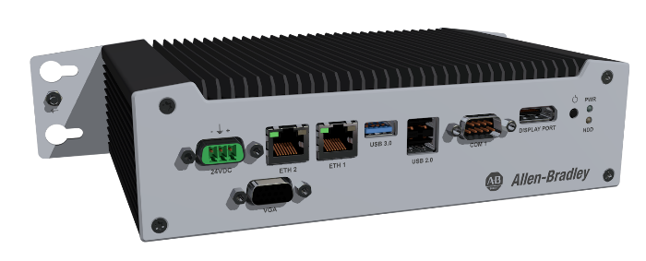
Managed Thin Client Benefits – VV5200
Rockwell Automation® Industrial Thin Client Hardware
Lower total cost of ownership than PCs over the lifetime of the system:
Integrates with ThinManager® software for efficient centralized management
Less likely to fail because they don’t have hard drives or fans and they contain industrial grade components suitable for harsh environments
Easier to replace when they do fail, significantly reducing downtime
Smaller and require less power to operate and cool
Fewer client operating systems to manage
More secure:
No local storage – nothing is stored on device
Can eliminate access to the Windows Desktop
USB ports are disabled by default for everything except and keyboards/mice
Notes:
Being ThinManager-Ready means the VersaView series has greater value and functionality than standard commercial grade thin client. ThinManager actually increases the value of the hardware investment by providing additional features and functionality that goes beyond what any unmanaged thin client can do. By combining the VersaView series hardware with ThinManager, customers receive the most powerful thin client solution available for the industrial market.

Slide 11
ThinManager V-FLEX Licensing Overview
Users now can purchase single ThinManager connection licenses that have no network or location restrictions and provide for bulk purchase discounts.
ADVANTAGES OF V-FLEX LICENSING:
Central management of ThinManager client connections.
Use across multiple facilities—no limitations on the number of locations, networks and servers.
Ability to purchase and add additional licenses only when and where they are needed with volume discount pricing.
Access to a private ThinManager license server portal for creating and distributing licenses for use.
Deliver ThinManager client connections with maximum flexibility on an as-needed basis to any of your facilities around the world.
ThinManager V-FLEX licensing is a single ThinManager XLr individual terminal connection license that can be purchased one-at-a-time in any quantity.
They can be deployed over an unlimited number of ThinServer pairs (primary/backup) at an unlimited number of locations on multiple networks.
Notes:
How is it Licensed?
ThinManager is licensed based on 3 factors:
Terminal Connection License
Redundancy
Platform Maintenance
The Terminal Connection License is defined by how many terminals/devices are concurrently connected to ThinManager. These are sold in 5, 10 and 25 packs (which are additive) as well as an Enterprise Server license that provides Unlimited Terminal Connections.
Redundancy provides a pair of ThinManager installations that are automatically synchronized. Either installation can deliver firmware and terminal profiles.
Platform Maintenance is equivalent to TechConnect. In exchange for annual fee, the end user receives the latest version of ThinManager, Live Tech Support and trade-in value for their license towards an Enterprise Server license.
Redundancy is having 2 ThinManager installations that are automatically synchronized -> either of which can deliver firmware and profiles to the terminals managed by ThinManager.
None
Mirrored – provides a pair of ThinManager installs which are automatically synchronized, but there is a restriction - changes to the ThinManager configuration can only be made from the Primary ThinManager installation
Full – similar to Mirrored except there is no restriction – ThinManager configuration changes can be made from either ThinManager installation
Platform Maintenance (PM) is ThinManager’s form of TechConnect. This is an annual fee that provides the latest release of ThinManager, access to live tech support, and credit towards upgrades in the future.
There are 3 special licenses available:
Muni Pack – offered only in 25 terminal connection counts and for municipalities only – can split the terminal connection count across multiple sites. Can be purchased with No Redundancy or Full Redundancy only.
Enterprise Server – provides an unlimited number of terminal connections on a single owned network. Includes Full Redundancy and 1st Year of Platform Maintenance. Restriction: Cannot be used on networks that are public, leased or non-company owned.
FLEX (100, 250, 500) – provides a terminal count limit, but can be installed on as many networks as needed. RESTRICTION: Can only be utilized within a single Business Unit of a company.

Slide 12
ThinManager V-FLEX Licensing Overview
Both FTA and TMA are available in two formats:
Perpetual+Maintenance
Subscription exclusively through the software portal.
Activation
V-FLEX TMA is activated through the licensing.thinmanager.com ThinManager Licensing Website.
V-FLEX FTA is activated either through FactoryTalk Activation Manager or the activate.rockwellautomation.com FTA Website.
Redundancy
This Redundancy Companion license is sold separately and cannot function independently since it is sold for a 50% reduced cost.

